Slide 1
JEPPIAAR INSTITUTE OF TECHNOLOGY
TEAM MEMBERS:
SUBJECT NAME: PROGRAMMING IN C
SUBJECT TOPIC:
LINEAR SEARCH
BINARY SEARCH
SELECTION SORT
GUIDED BY:
Mr.H.SHINE
KUMARESH. - 210619104025
LEKHA KAMALESHWARI - 210619104026
LEO CHRISTY.C - 210619104027
MADESH KUMAR. - 210619105028
MANIGANDAN.P - 210619104029
MANIKANDAN.S -210619104030

Slide 2
LINEAR SEARCH PROGRAM:
#include<stdio.h>
int main()
{
int a[50],n,key,found=0,i;
printf(“Enter the no of elements :”);
scanf(“%d”,&n);
printf(“\n Enter the elements:”);
for(i=0;i<n;i++)
{

Slide 3
scanf(“%d\n”,&a[i]);
}
printf(“Enter the search element:”);
scanf(“%d”,&key);
for(i=0;i<n;i++)
{
if(key==a[i])
{
found=1;
break;
}
}

Slide 4
if(found==1)
{
printf(“The element is found.\n”);
}
else
{
printf(“The element is not found.\n”);
}
return 0;
}

Slide 5
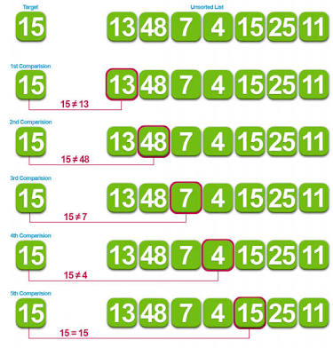
OUTPUT:
Enter the no of elements : 5
Enter the elements:
10
25
6
18
13
Enter the search element:6
The element is found.

Slide 6
BINARY SEARCH PROGRAM:
#include<stdio.h>
int main()
{
int a[50],n,key,low,high,mid,i,j,t,found=0;
printf(“Enter the no of elements:”);
scanf(“%d”,&n);
printf(“\n Enter the elements:”);
for(i=0;i<n;i++)
{

Slide 7
scanf(“%d\t”&a[i]);
}
for(i=0;i<n-1;i++)
{
for(j=0;j<n;j++)
{
if(a[i]>a[j])
{
t=a[i];
a[i]=a[j];
a[j]=t;
}
}
}

Slide 8
printf(“\n Sorted elements are:\n”);
for(i=0;i<n;i++)
{
printf(“%d\n”,a[i]);
}
printf(“\n Enter the search element:”);
scanf(“%d”,&key);
low=0;
high=n-1;
while(low<=high)
{
mid=(low+high)/2;

Slide 9
if(key<a[mid])
{
high=mid-1;
}
else if(key>a[mid])
{
low=mid+1;
}
if(key==a[mid])
{
found=1;
break;
}
}

Slide 10
if(found==1)
{
printf(“\n The element is found.”);
}
else
{
printf(“\n The element is not found.”);
}
return 0;
}

Slide 11
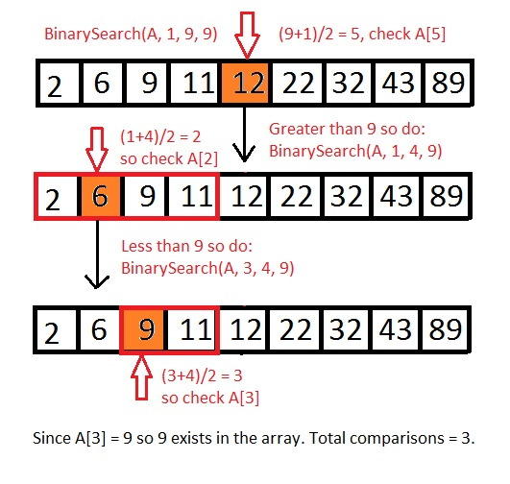
OUTPUT:
Enter the no of elements:5
Enter the elements:32 53 24 11 67
Sorted elements are:
11
24
32
53
67
Enter the search element:32
The element is found.

Slide 12
SELECTION SORT PROGRAM:
#include<stdio.h>
int main()
{
int n,i,j,a[20];
printf(“Enter the no of elements:”);
scanf(“%d”,&n);
printf(“\n Enter the elements:”);
for(i=0;i<n;i++)
{

Slide 13
scanf(“%d\n”,&a[i]);
}
for(i=0;i<n-1;i++)
{
for(j=i+1;j<n;j++)
{
if(a[i]>a[j])
{
t=a[i];
a[i]=a[j];
a[j]=t;
}
}
}

Slide 14
printf (“Sorted elements are:\n”);
for( i=0; i< n; i++)
{
printf (“%d\n” ,&a[i]);
}
return 0:
}

Slide 15
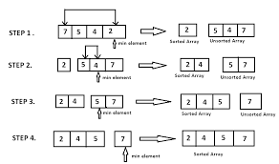
OUTPUT:
Enter the no of elements:5
Enter the elements:
54
24
36
12
76
Sorted elements are:
12
24
36
54
76

Slide 16
THANK YOU

